Slide 1
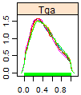
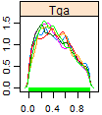
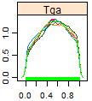
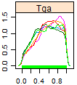
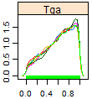
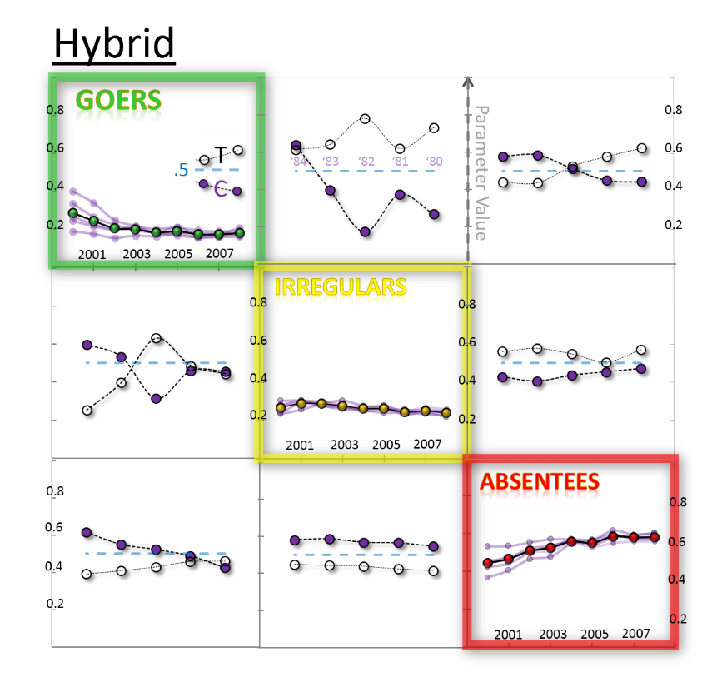
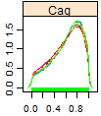
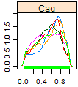
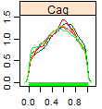
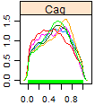
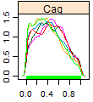
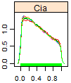
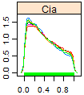
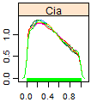
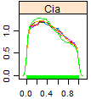
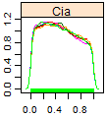
WinBugs
Hybrid
Point estimates are the descriptors
of a posterior distribution. We used
means, but could have used
medians or MLEs
‘84
‘83
‘82
‘81
‘80
‘84
‘83
‘82
‘81
‘80

Slide 2
Original EMOSA specification
New EMOSA specification
Hybrid
Contagion
Diffusion

Slide 3

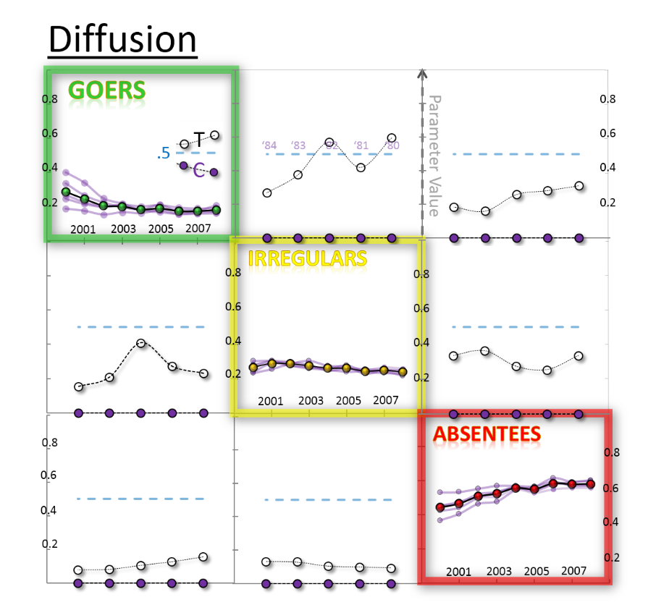

Gauss
old/original MatLab

Slide 4



Beta
old/original WinBugs

Slide 5
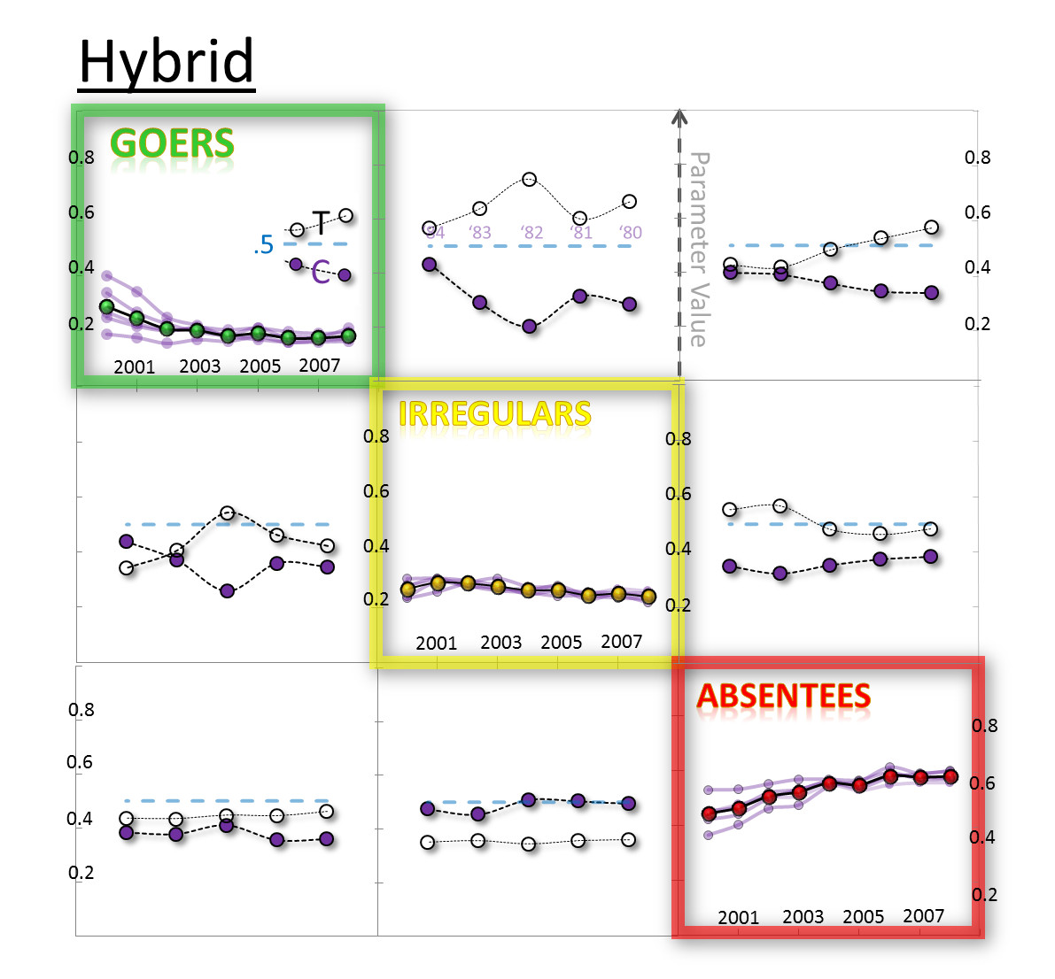
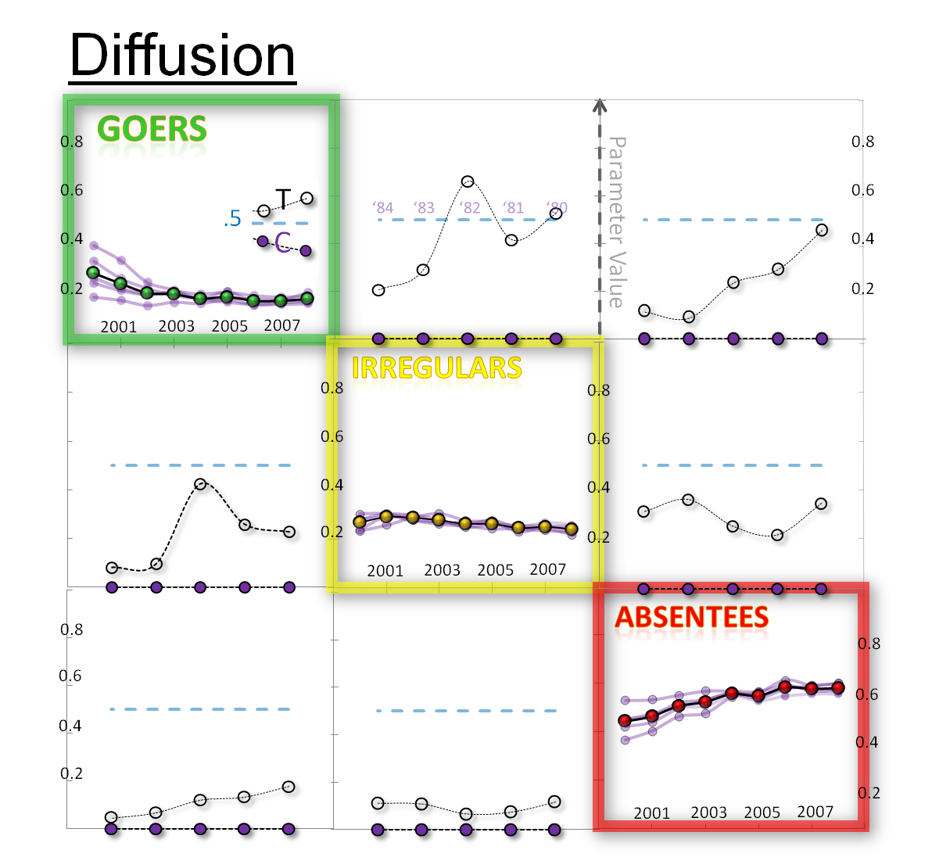
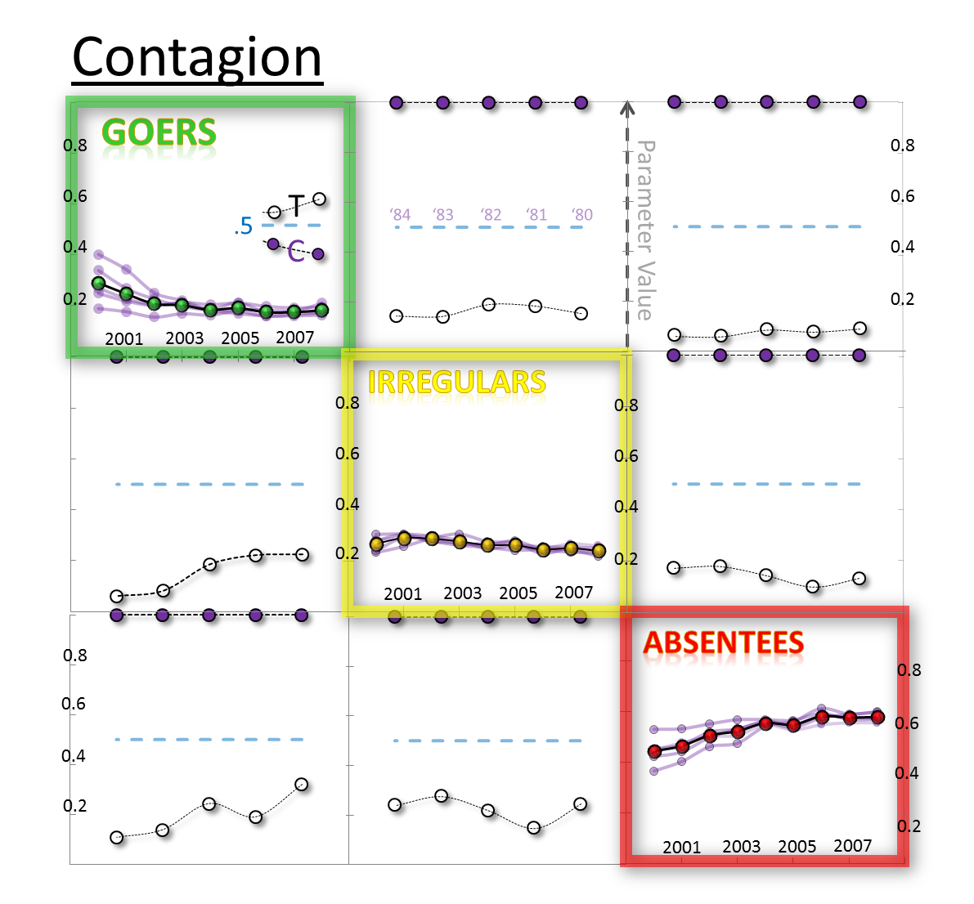
Gauss
new WinBugs

Slide 6
Gauss
old/original MatLab

Slide 7
Type of predictions
STEP
2001
2002
…
2008
Predicted
FULL
2001
2002
…
2008
Predicted
2000
2001
2002
…
2008
Observed
2000
2001
2002
…
2008
Observed
STEP forecast
the values of prevalences for each next year
are modeled from the observed values
of the previous year
Useful in predicting person’s state next year
STEP
FULL
FULL forecast
the values of prevalences for each next year
are modeled from the predicted values
of the previous year
Useful in explaining person’s trajectory
2000
2000
2001
2001
2001
2001
2002
2002
2002
2002
…
…
…
…
2008
2008
2008
2008
Observed
Predicted
Observed
Predicted

Slide 8


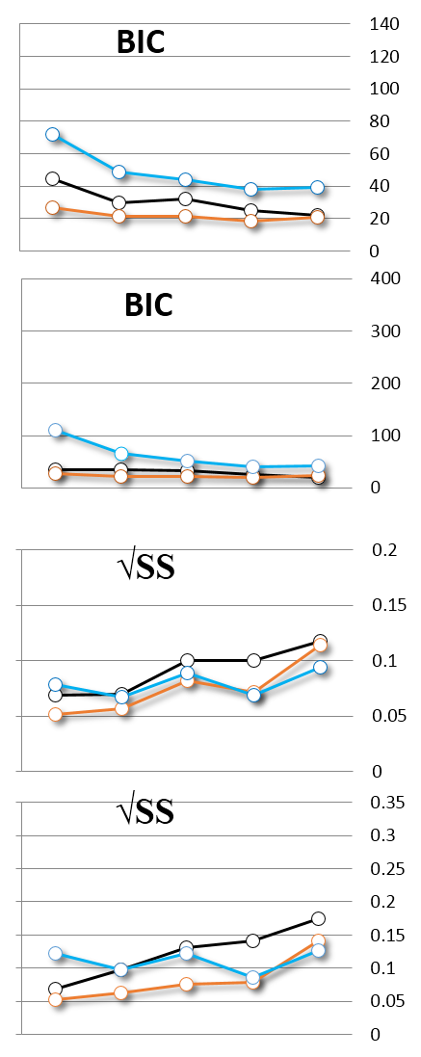
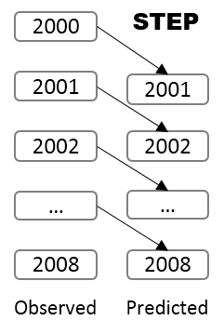
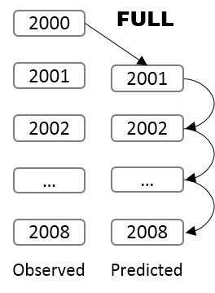
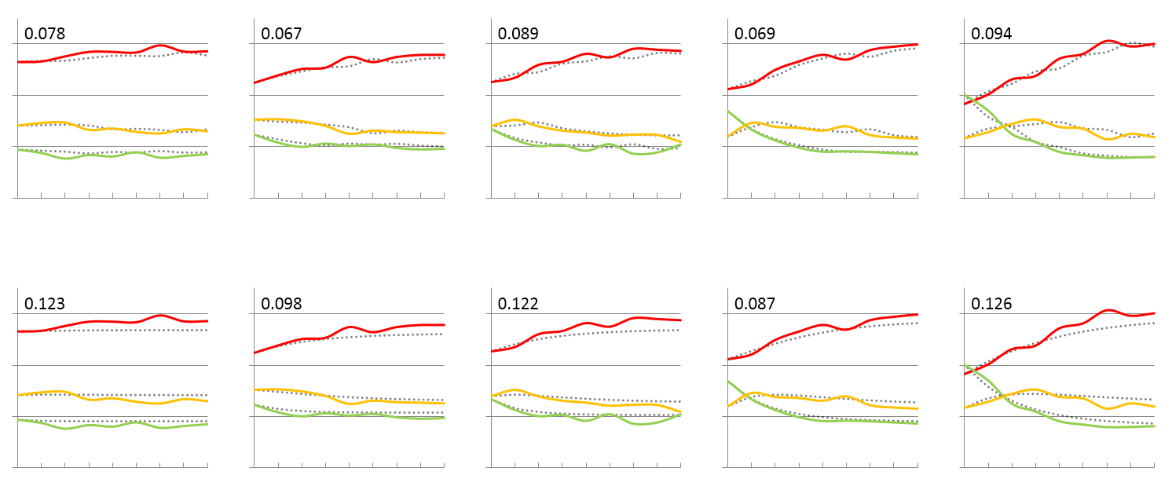
EMOSA Specification
WBn
WBo
ML
Hyb
Hyb
Hyb
Null
Con
Con
Con
Predicted
O b s e r v e d
Dif
Dif
Dif
Forecast
‘80
‘81
‘82
‘83
‘84
Goers
Irregulars
Absentees
gauss
beta
gauss
.6
.6
.6
.6
.4
.4
.4
.4
.2
.2
.2
.2
born in
born in
born in
born in
born in
1980
1981
1982
1983
1984
.6
.6
.6
.6
.4
.4
.4
.4
.2
.2
.2
.2
year
1
2
3
4
5
6
7
8
0
1
2
3
4
5
6
7
8
0
1
2
3
4
5
6
7
8
0
1
2
3
4
5
6
7
8
0
1
2
3
4
5
6
7
8
2000

Slide 9

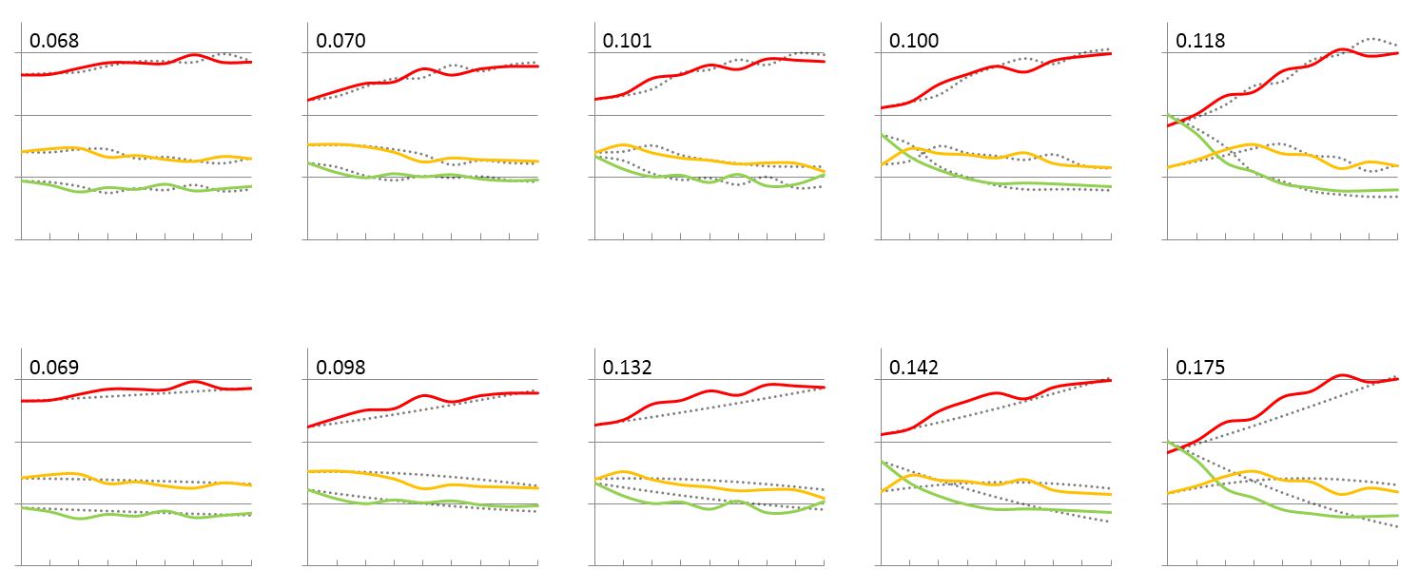
EMOSA Specification
WBn
WBo
ML
Hyb
Hyb
Hyb
Null
Con
Con
Con
Predicted
O b s e r v e d
Dif
Dif
Dif
Forecast
‘80
‘81
‘82
‘83
‘84
Goers
Irregulars
Absentees
gauss
beta
gauss
.6
.6
.6
.6
.4
.4
.4
.4
.2
.2
.2
.2
born in
born in
born in
born in
born in
1980
1981
1982
1983
1984
.6
.6
.6
.6
.4
.4
.4
.4
.2
.2
.2
.2
year
1
2
3
4
5
6
7
8
0
1
2
3
4
5
6
7
8
0
1
2
3
4
5
6
7
8
0
1
2
3
4
5
6
7
8
0
1
2
3
4
5
6
7
8
2000

Slide 10
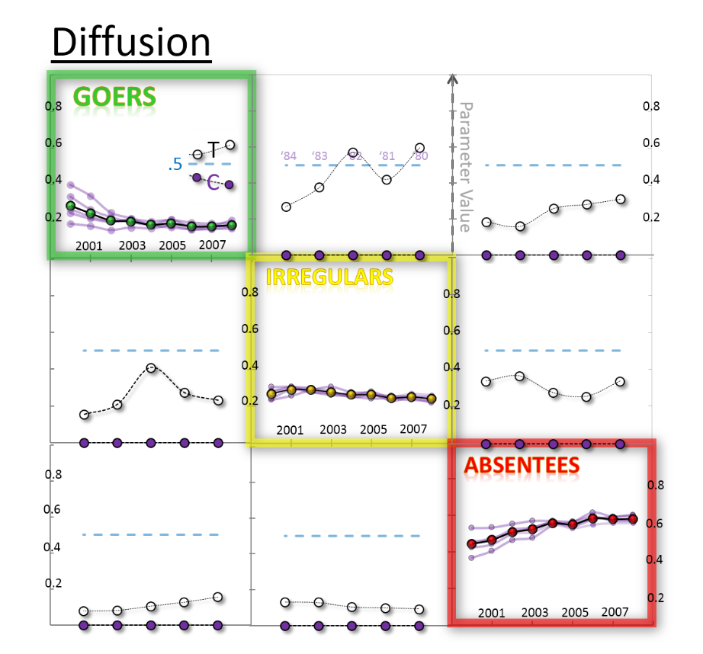
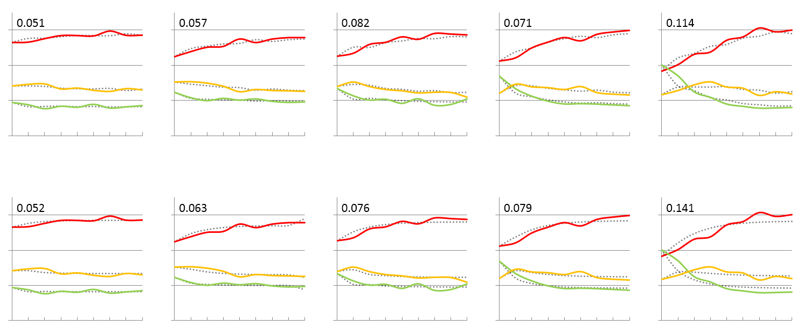
EMOSA Specification
WBn
WBo
ML
Hyb
Hyb
Hyb
Null
Con
Con
Con
Predicted
O b s e r v e d
Dif
Dif
Dif
Forecast
‘80
‘81
‘82
‘83
‘84
Goers
Irregulars
Absentees
gauss
beta
gauss
.6
.6
.6
.6
.4
.4
.4
.4
.2
.2
.2
.2
born in
born in
born in
born in
born in
1980
1981
1982
1983
1984
.6
.6
.6
.6
.4
.4
.4
.4
.2
.2
.2
.2
year
1
2
3
4
5
6
7
8
0
1
2
3
4
5
6
7
8
0
1
2
3
4
5
6
7
8
0
1
2
3
4
5
6
7
8
0
1
2
3
4
5
6
7
8
2000

Slide 11

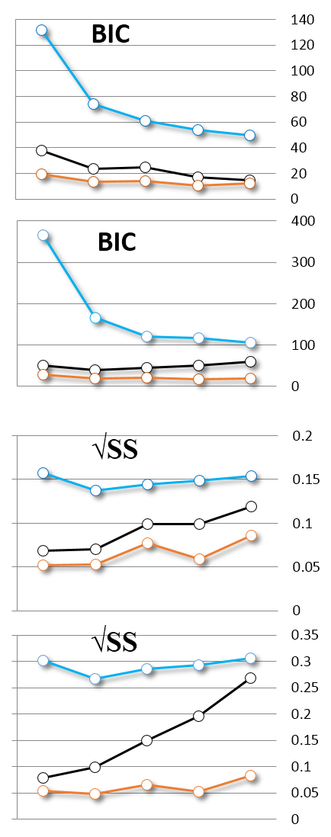
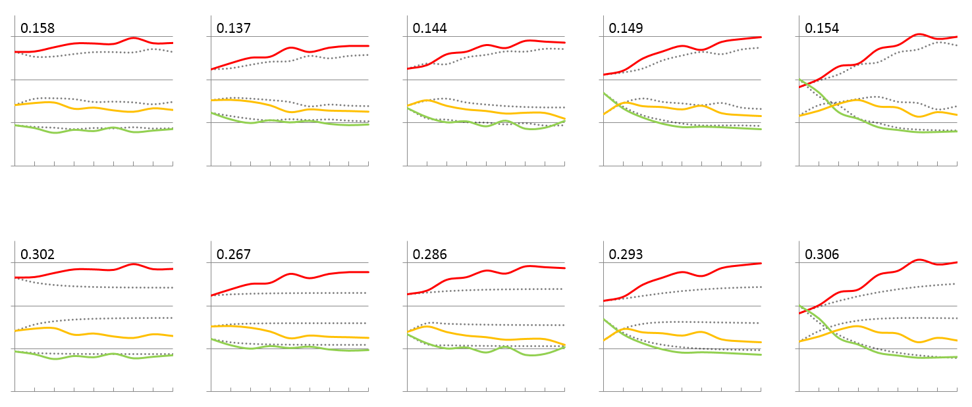
EMOSA Specification
WBn
WBo
ML
Hyb
Hyb
Hyb
Null
Con
Con
Con
Predicted
O b s e r v e d
Dif
Dif
Dif
Forecast
‘80
‘81
‘82
‘83
‘84
Goers
Irregulars
Absentees
gauss
beta
gauss
.6
.6
.6
.6
.4
.4
.4
.4
.2
.2
.2
.2
born in
born in
born in
born in
born in
1980
1981
1982
1983
1984
.6
.6
.6
.6
.4
.4
.4
.4
.2
.2
.2
.2
year
1
2
3
4
5
6
7
8
0
1
2
3
4
5
6
7
8
0
1
2
3
4
5
6
7
8
0
1
2
3
4
5
6
7
8
0
1
2
3
4
5
6
7
8
2000

Slide 12

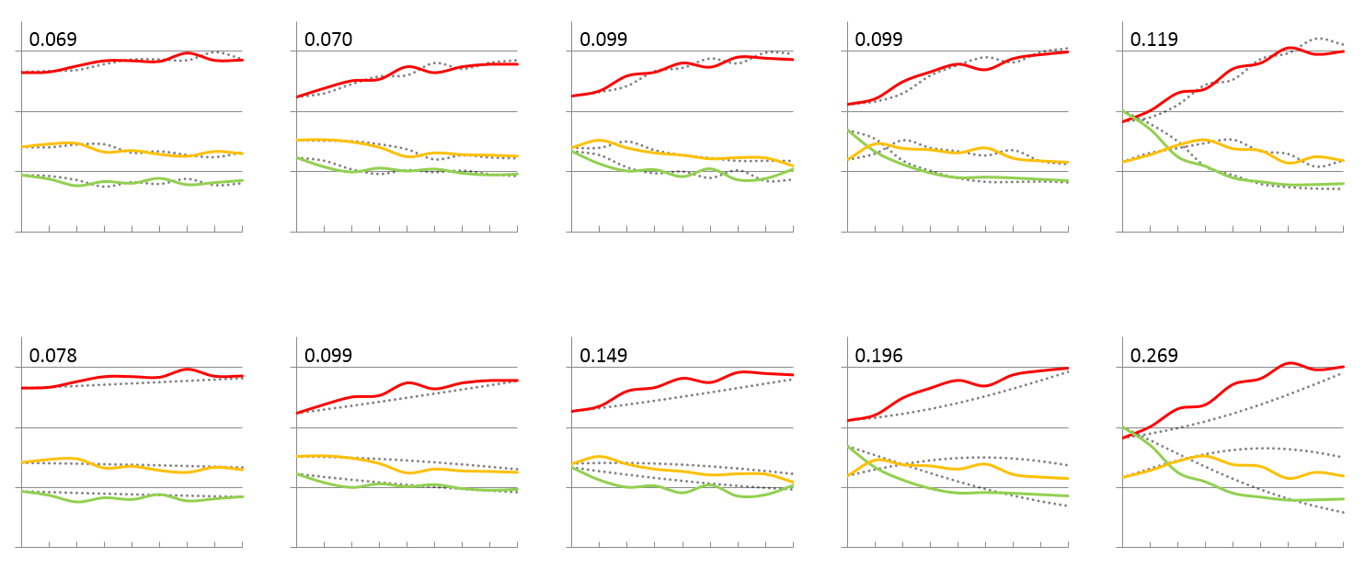
EMOSA Specification
WBn
WBo
ML
Hyb
Hyb
Hyb
Null
Con
Con
Con
Predicted
O b s e r v e d
Dif
Dif
Dif
Forecast
‘80
‘81
‘82
‘83
‘84
Goers
Irregulars
Absentees
gauss
beta
gauss
.6
.6
.6
.6
.4
.4
.4
.4
.2
.2
.2
.2
born in
born in
born in
born in
born in
1980
1981
1982
1983
1984
.6
.6
.6
.6
.4
.4
.4
.4
.2
.2
.2
.2
year
1
2
3
4
5
6
7
8
0
1
2
3
4
5
6
7
8
0
1
2
3
4
5
6
7
8
0
1
2
3
4
5
6
7
8
0
1
2
3
4
5
6
7
8
2000

Slide 13
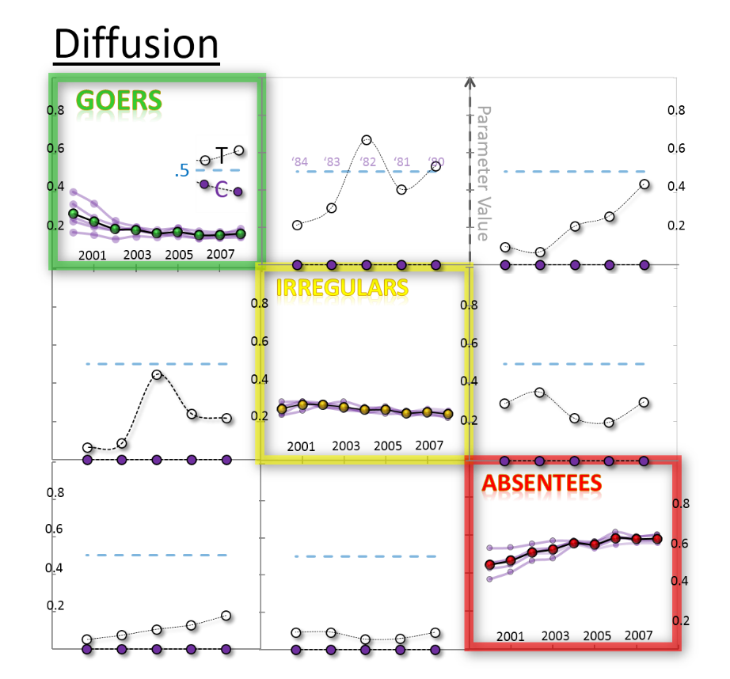
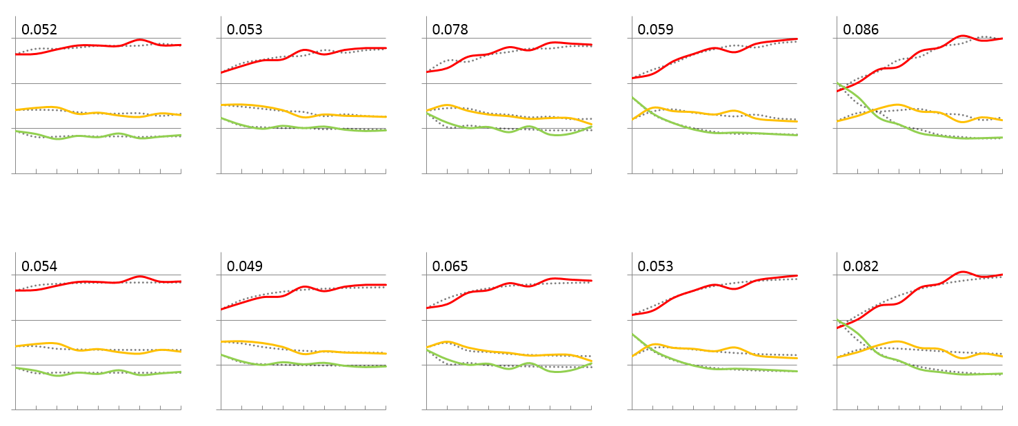
EMOSA Specification
WBn
WBo
ML
Hyb
Hyb
Hyb
Null
Con
Con
Con
Predicted
O b s e r v e d
Dif
Dif
Dif
Forecast
‘80
‘81
‘82
‘83
‘84
Goers
Irregulars
Absentees
gauss
beta
gauss
.6
.6
.6
.6
.4
.4
.4
.4
.2
.2
.2
.2
born in
born in
born in
born in
born in
1980
1981
1982
1983
1984
.6
.6
.6
.6
.4
.4
.4
.4
.2
.2
.2
.2
year
1
2
3
4
5
6
7
8
0
1
2
3
4
5
6
7
8
0
1
2
3
4
5
6
7
8
0
1
2
3
4
5
6
7
8
0
1
2
3
4
5
6
7
8
2000

Slide 14
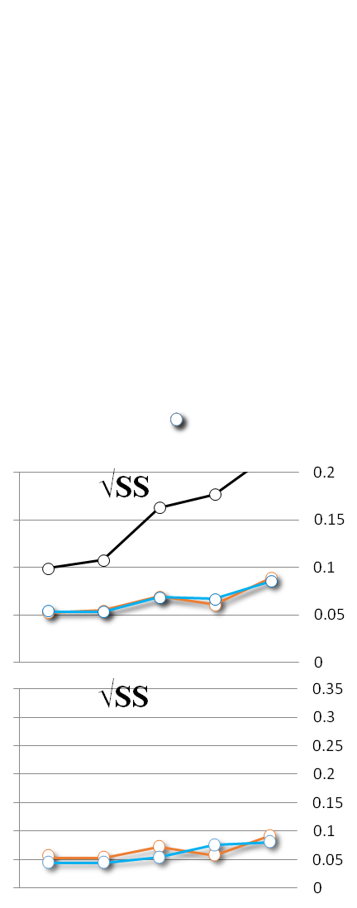
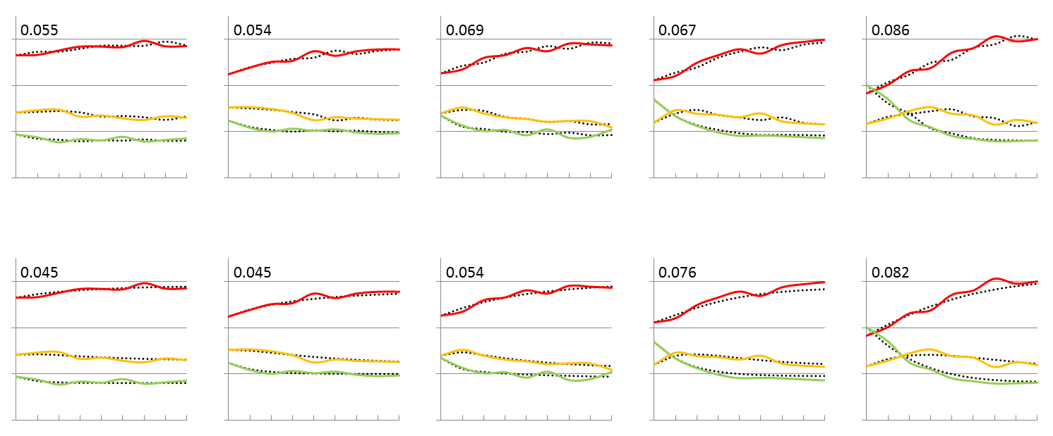
EMOSA Specification
WBn
WBo
ML
Hyb
Hyb
Hyb
Null
Con
Con
Con
Predicted
O b s e r v e d
Dif
Dif
Dif
Forecast
‘80
‘81
‘82
‘83
‘84
Goers
Irregulars
Absentees
gauss
beta
gauss
.6
.6
.6
.6
.4
.4
.4
.4
.2
.2
.2
.2
born in
born in
born in
born in
born in
1980
1981
1982
1983
1984
.6
.6
.6
.6
.4
.4
.4
.4
.2
.2
.2
.2
year
1
2
3
4
5
6
7
8
0
1
2
3
4
5
6
7
8
0
1
2
3
4
5
6
7
8
0
1
2
3
4
5
6
7
8
0
1
2
3
4
5
6
7
8
2000

Slide 15
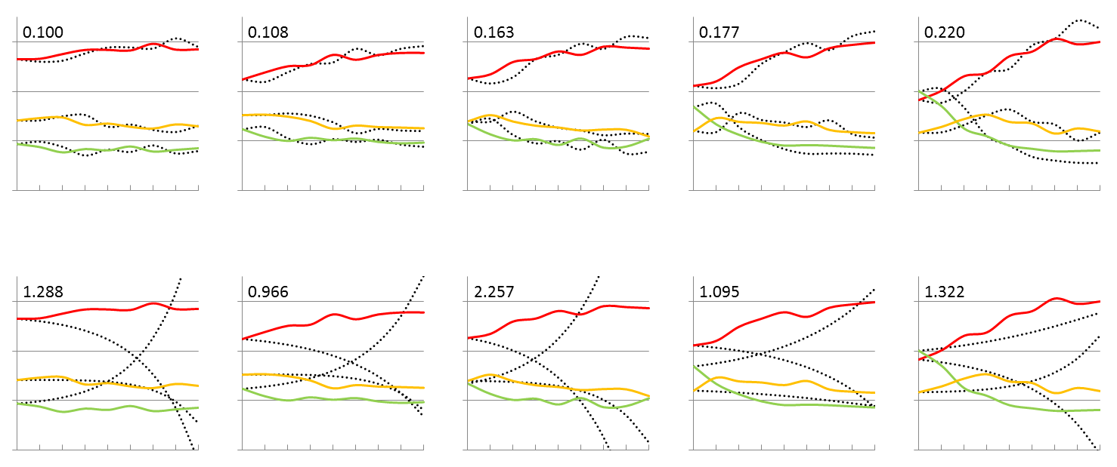
EMOSA Specification
WBn
WBo
ML
Hyb
Hyb
Hyb
Null
Con
Con
Con
Predicted
O b s e r v e d
Dif
Dif
Dif
Forecast
‘80
‘81
‘82
‘83
‘84
Goers
Irregulars
Absentees
gauss
beta
gauss
.6
.6
.6
.6
.4
.4
.4
.4
.2
.2
.2
.2
born in
born in
born in
born in
born in
1980
1981
1982
1983
1984
.6
.6
.6
.6
.4
.4
.4
.4
.2
.2
.2
.2
year
1
2
3
4
5
6
7
8
0
1
2
3
4
5
6
7
8
0
1
2
3
4
5
6
7
8
0
1
2
3
4
5
6
7
8
0
1
2
3
4
5
6
7
8
2000

Slide 16
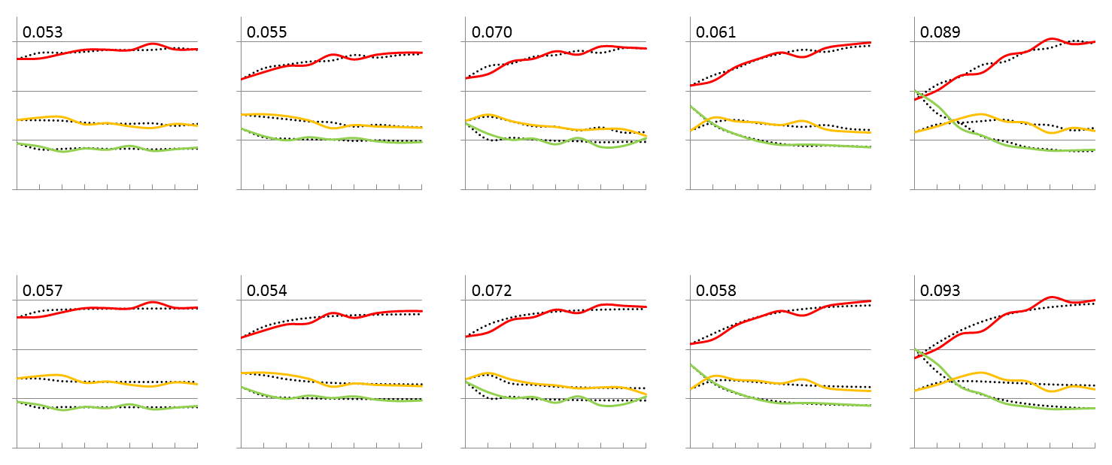
EMOSA Specification
WBn
WBo
ML
Hyb
Hyb
Hyb
Null
Con
Con
Con
Predicted
O b s e r v e d
Dif
Dif
Dif
Forecast
‘80
‘81
‘82
‘83
‘84
Goers
Irregulars
Absentees
gauss
beta
gauss
.6
.6
.6
.6
.4
.4
.4
.4
.2
.2
.2
.2
born in
born in
born in
born in
born in
1980
1981
1982
1983
1984
.6
.6
.6
.6
.4
.4
.4
.4
.2
.2
.2
.2
year
1
2
3
4
5
6
7
8
0
1
2
3
4
5
6
7
8
0
1
2
3
4
5
6
7
8
0
1
2
3
4
5
6
7
8
0
1
2
3
4
5
6
7
8
2000

Slide 17
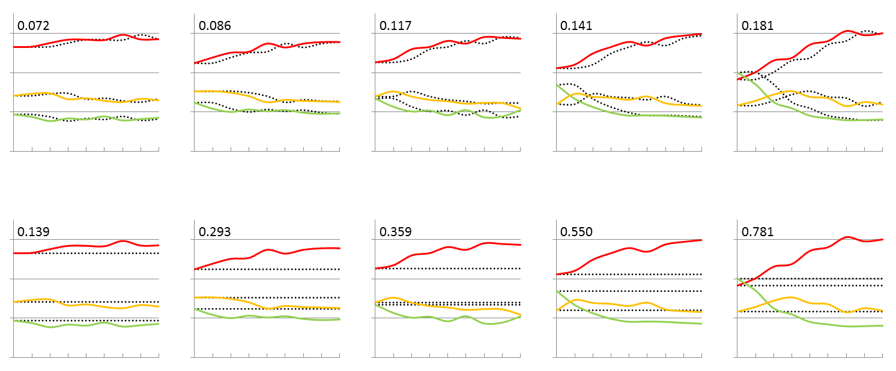
NULL MODEL
WBn
WBo
ML
Hyb
Hyb
Hyb
Null
Con
Con
Con
Predicted
O b s e r v e d
Dif
Dif
Dif
Goers
Irregulars
Absentees
gauss
beta
gauss
.6
.6
.6
.6
.4
.4
.4
.4
.2
.2
.2
.2
born in
born in
born in
born in
born in
1980
1981
1982
1983
1984
.6
.6
.6
.6
.4
.4
.4
.4
.2
.2
.2
.2
year
1
2
3
4
5
6
7
8
0
1
2
3
4
5
6
7
8
0
1
2
3
4
5
6
7
8
0
1
2
3
4
5
6
7
8
0
1
2
3
4
5
6
7
8
2000

Slide 18
Diffusion
Contagion
Hybrid
old-WinBUGS - Beta
Hybrid
Contagion
Diffusion
New Specification -Gauss
‘80
‘81
‘82
‘83
‘84
‘80
‘81
‘82
‘83
‘84
Forecast
‘80
‘81
‘82
‘83
‘84
‘80
‘81
‘82
‘83
‘84
Notes:
This file is linked to the “examining the WinBugs results”and “examining the MatLab results.xlsx” files

Slide 19
Hybrid
Contagion
Diffusion
Old-MatLab-Gauss
Hybrid
Contagion
Diffusion
New Specification -Gauss
‘80
‘81
‘82
‘83
‘84
‘80
‘81
‘82
‘83
‘84
Forecast
‘80
‘81
‘82
‘83
‘84
‘80
‘81
‘82
‘83
‘84
Notes:
This file is linked to the “examining the WinBugs results”and “examining the MatLab results.xlsx” files

Slide 20
WinBUGS
OLD/Original Beta
WinBUGS
NEW
Gauss
DIC
Worse fit
Better fit
Notes:
This is form the file “examining the new WINBUGS results.xlsx”

